Slide 1
“BAD” DATA
   
e
Sun
Sun
e

Slide 2
Overview
Bad Data
Learning from unexpected results
Isotherm Analysis
Research

Slide 3
Sources of “Bad” Data
Error in preparation of samples
  mass or volume measurement error
  contamination
  improper storage
  sample substitution
  sample loss
  samples with high heterogeneity
Apparatus failures
  leaks
  incompatible materials
  inadequate control of an important parameter

Slide 4
Instrument Errors
detector malfunction
below detection limit or above maximum
interference
software (instrument or computer)
hardware (analog to digital converter, power supply,...)
calibration

Slide 5
More sources of “Bad Data”
Error in data analysis
  numerical error (data entry)
  units (classic errors of factors of 10 and factors of 1000)
  incorrectly applied theory
Error in theory

Slide 6
Bad Data aren’t Bad!
“Bad” data usually means the results were unexpected
  perhaps unorthodox!
    Copernicus “Concerning the Revolutions of the Celestial Bodies”1543
    Papal Index of forbidden books until 1835
  _____________________
Data do not lie!
Data always mean something
If you ignore data that you don’t understand you are missing an opportunity to learn
Bad data for 292 years!

Slide 7
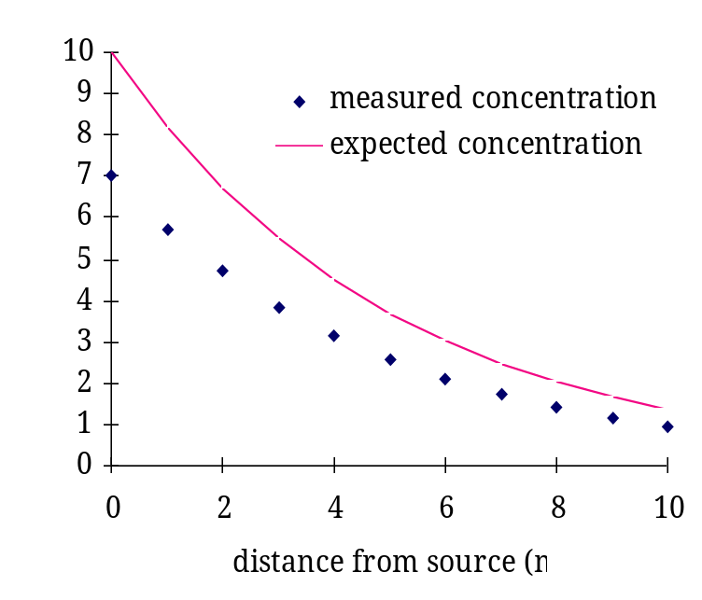
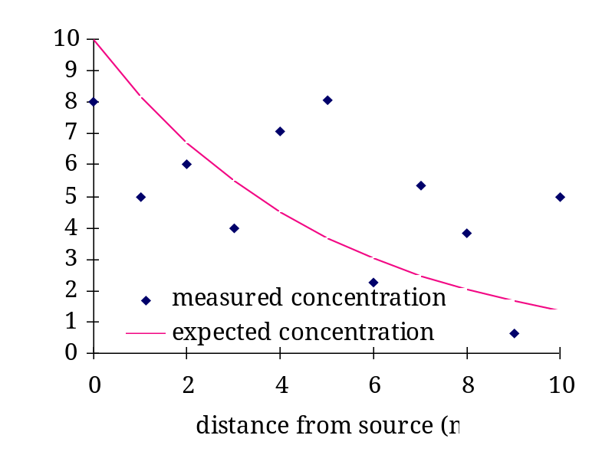
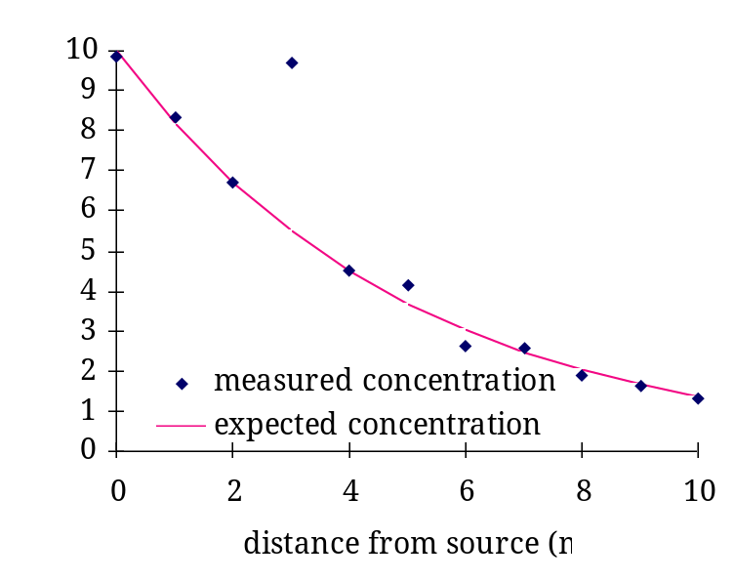
Unexpected Results
Lack of repeatability (poor precision)
  scatter for all data
  outlier
  systemic error

Slide 8
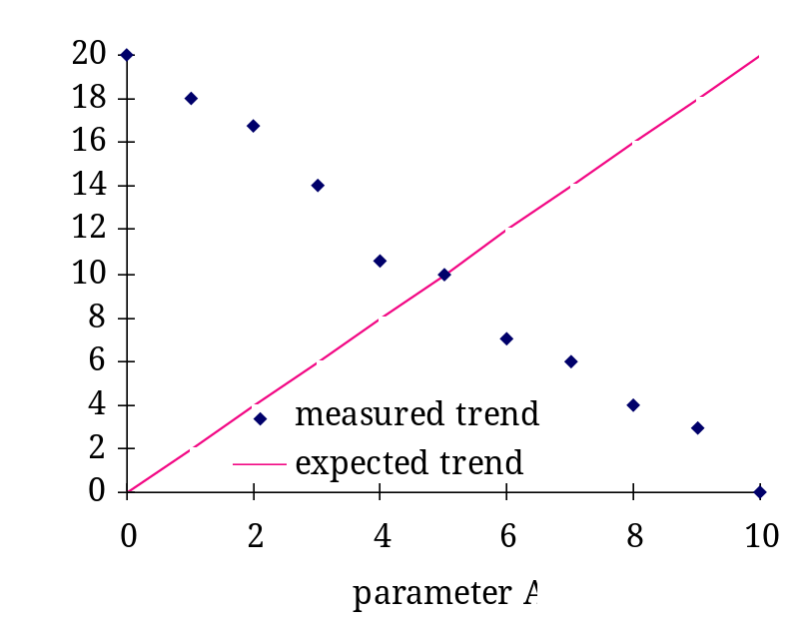
Unexpected Results
Inconsistent with theory
  mass balances indicate loss or gain of mass
inconsistent with previous results
e
Sun
Sun
e

Slide 9
Responses to Unexpected Results
Determine accuracy of technique by analyzing known samples
Determine precision of technique by analyzing replicates
Evaluate propagation of errors through analysis
  are you trying to measure the difference between two large numbers?
  is the precision of the measurement similar to the magnitude of the estimate?
Are you not controlling an important parameter?
Is the parameter that you are studying insignificant?

Slide 10
Isotherm Analysis Pointers
Units
  Express mass of VOC in grams
  Express concentrations as g per mL
  Remember GC injection volume was 0.1 mL
Use names to keep track of parameters in spreadsheet
Build sheet from left to right

Slide 11
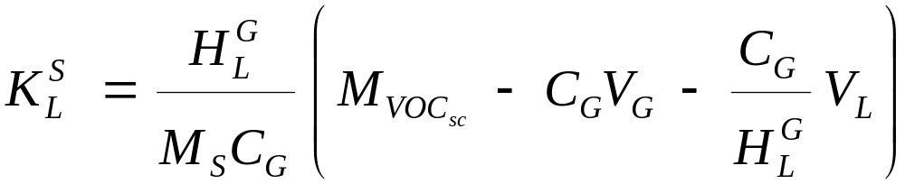
More Pointers
Soil density = 1.6 g/mL
Soil moisture content is 13%
Soil mass was close to 20 g
Analyze the 3 data sets as sets
  Use the data from one group to calculate a single value for each parameter
You will get 3 estimates for each parameter
spreadsheet

